Slide 1

A Project Review Meeting on Hotel Room Booking Engine
By
Name K.GIREESH 2520090215
Name CH.CHARAN SAI 2520030321
Team Number: 23
Under the guidance of
Dr. P. Nirmala Jyothi
Associate Professor
Department of Computer Science and Engineering
Koneru Lakshmaiah Education Foundation (Deemed to be University estd. u/s. 3 of the UGC Act, 1956) Off-Campus: Bachupally-Gandimaisamma Road, Bowrampet, Hyderabad, Telangana - 500 043. Phone No: 7815926816, www.klh.edu.in

Slide 2
Outline of the Presentation
Abstract
Introduction
Problem Statement
Project Flow Diagram
Objectives with Justification
Modules[Frontend web pages]
Expected Outcomes of the Proposed Work
Conclusion
References

Slide 3
Abstract
The Hotel Room Booking Engine is a web-based application designed to streamline the process of searching, selecting, and reserving hotel rooms online. The system provides a user-friendly interface for customers to browse available hotels, view room details, check real-time availability, and complete secure bookings.
The platform integrates core functionalities including user registration and login, hotel and room listings with filters, booking management, payment processing, and an admin dashboard for hotel managers to manage inventory and reservations.
Built using modern web technologies (React.js for frontend, Node.js/Express for backend, and MySQL for database), the project aims to deliver a scalable, responsive, and secure booking experience that bridges the gap between travelers and hotels effectively.

Slide 4
Introduction
The Hotel Room Booking Engine is designed to address the growing demand for digital hospitality solutions. In today's fast-paced travel environment, customers expect instant, convenient, and reliable hotel booking services accessible from any device.
Traditional hotel booking methods—phone calls, walk-ins, and third-party agencies—are time-consuming, error-prone, and lack real-time data. This project replaces those methods with a centralized, automated web platform.
The system targets three key user groups: (1) Travelers who need a seamless search-to-checkout experience; (2) Hotel Administrators who manage room inventory and reservations; and (3) System Admins who oversee platform operations.
Technologies used: React.js (Frontend), Node.js + Express.js (Backend), MySQL (Database), JWT (Authentication), Stripe API (Payment Gateway), and RESTful APIs for data communication between layers.

Slide 5
Problem Statement
The hospitality industry faces significant challenges with outdated and fragmented booking systems. Customers often encounter difficulties in finding and comparing hotel rooms in real-time, leading to poor user experiences and lost revenue.
Existing problems include: (1) No centralized platform for real-time room availability lookup; (2) Manual booking processes causing double-bookings and errors; (3) Lack of transparent pricing and room details for informed decision-making.
Hotel managers struggle with manual inventory management, resulting in overbooking, revenue loss, and poor customer satisfaction. There is an urgent need for an automated, reliable, and scalable booking engine.
This project proposes a web-based Hotel Room Booking Engine that eliminates these pain points by providing real-time availability, automated booking confirmation, secure payment handling, and centralized hotel management tools.

Slide 6
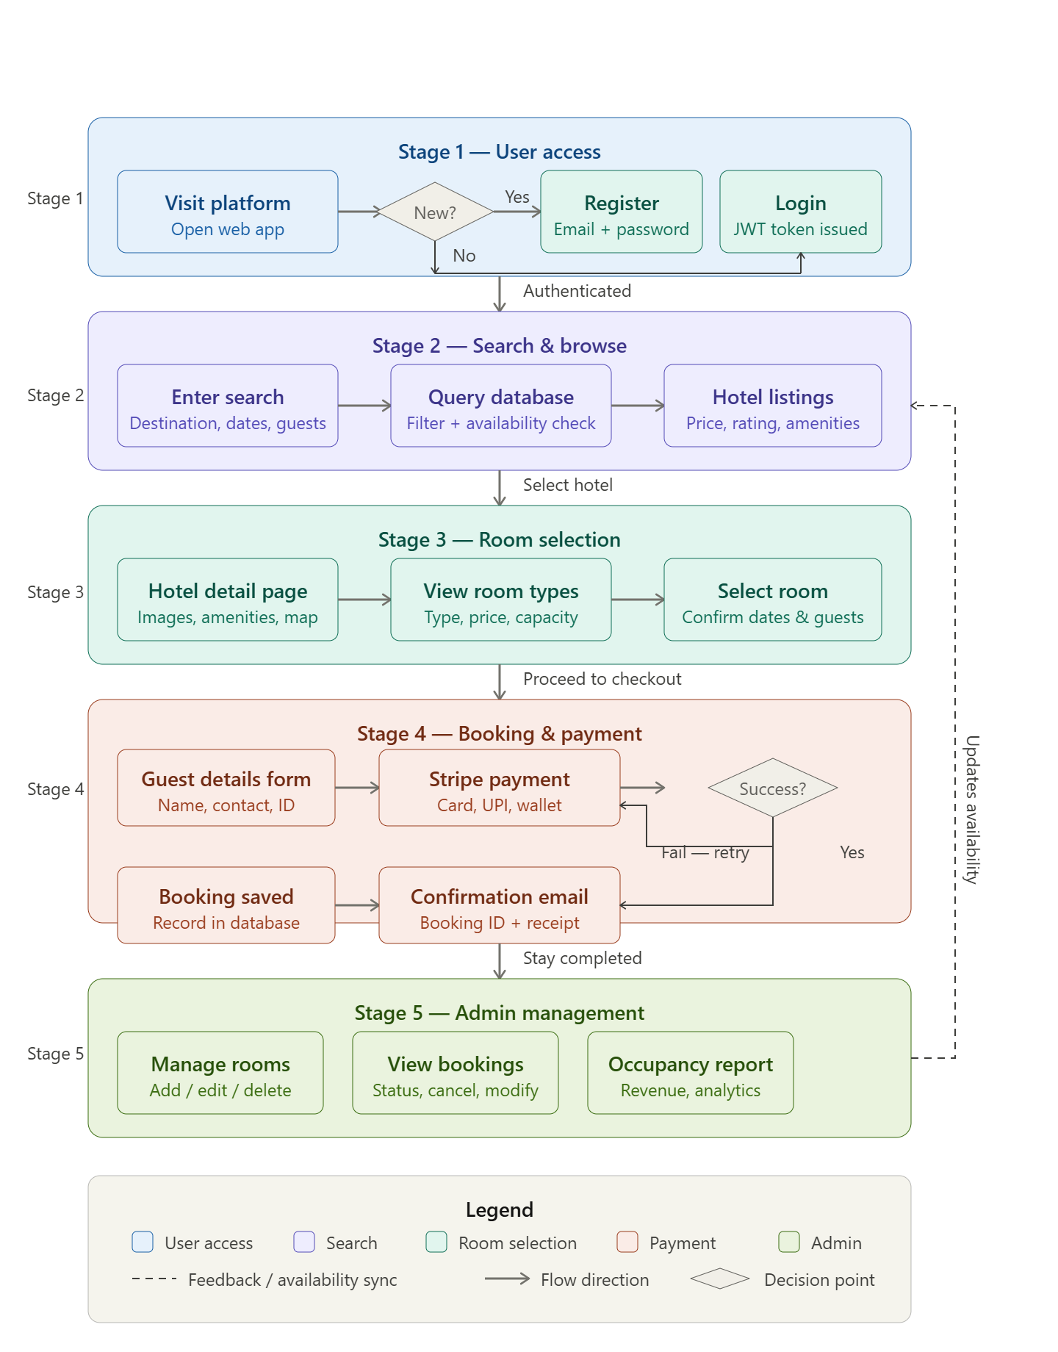
Project Flow Diagram

Slide 7
Objectives with Justification
Real-Time Room Availability — Prevent double-bookings and provide accurate inventory; critical for maintaining customer trust and hotel operational efficiency.
Secure User Authentication (JWT) — Protect personal and payment data with token-based sessions; ensures data privacy and personalized booking history.
Advanced Search with Filters — Enable travelers to narrow results by price, rating, amenities; reduces search friction and improves booking conversion rates.
Stripe Payment Gateway Integration — Provide safe and seamless checkout; real-time payment validation with instant booking confirmation emails.
Admin Dashboard for Hotel Management — Empower hotel staff to manage room inventory, view reservations, and analyze occupancy without technical expertise.
Cross-Device Responsive Design — Ensure full functionality on desktop, tablet, and mobile; modern travelers frequently book on smartphones.
Scalable RESTful API Architecture — Support system growth as hotel count and user base increases; allows future mobile app and third-party integrations.

Slide 8
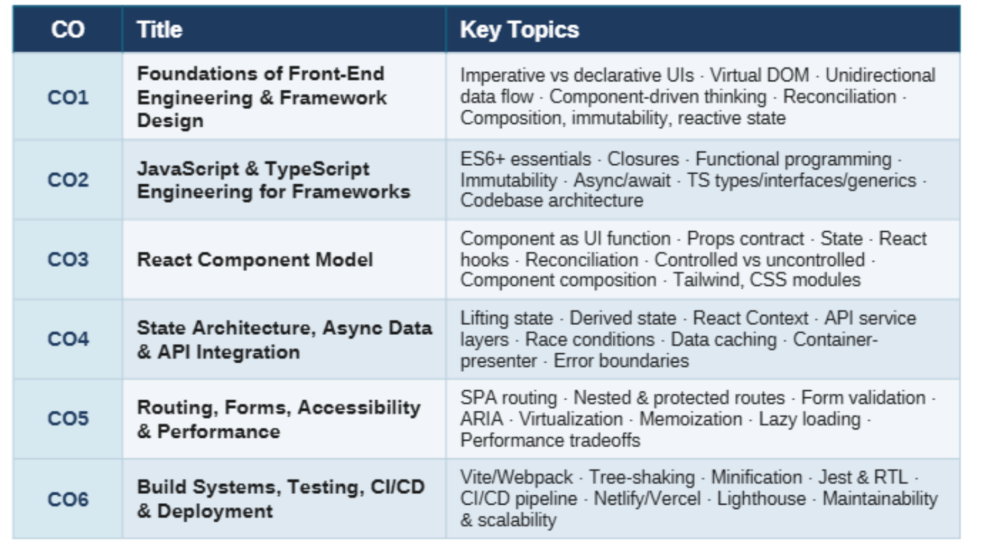
Modules [Frontend web pages]

Slide 9
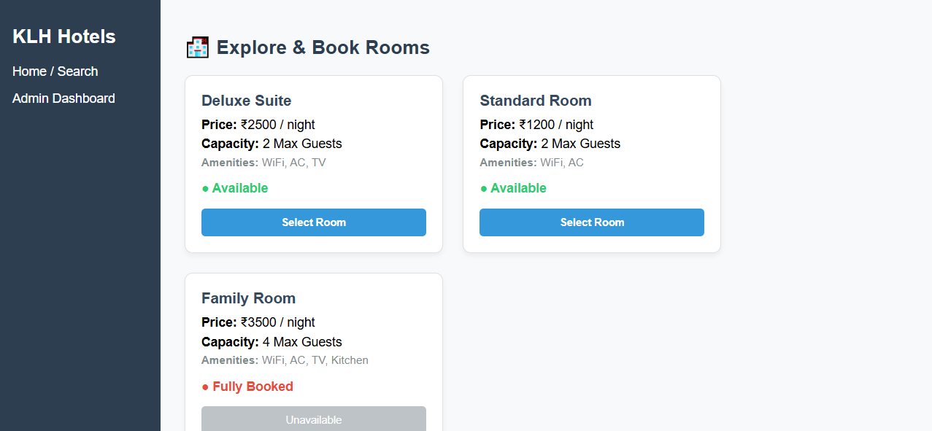
Expected Outcomes of the Proposed Work

Slide 10
Conclusion and Future Scope
Conclusion: The Hotel Room Booking Engine successfully addresses the core challenges of traditional hotel reservation systems. By delivering a centralized, automated, and user-friendly platform, the project bridges the gap between travelers and hotel operators through real-time bookings, secure payments, and efficient admin control.
The system was built using React.js, Node.js/Express, MySQL, JWT, and Stripe — ensuring a maintainable, performant, and scalable architecture. All primary objectives have been met: real-time availability, secure authentication, payment integration, and a fully functional admin dashboard.
Future Scope: (1) Native Mobile App (React Native) for iOS and Android; (2) AI-based Hotel Recommendation Engine using user history; (3) Multi-language and Multi-currency Support for international users; (4) Guest Review and Rating Module post-stay; (5) Dynamic Pricing based on seasonal demand; (6) Third-party Booking Platform API Integration (Booking.com, Expedia).

Slide 11
References
React Docs – react.dev
MDN JavaScript – developer.mozilla.org
TypeScript Docs – typescriptlang.org
Vite Docs – vitejs.dev
Jest Docs – jestjs.io
W3Schools React – w3schools.com/react
GeeksforGeeks – geeksforgeeks.org/reactjs
Roadtoreact – roadtoreact.com

Slide 12
Thank you

